Slide 1





AI & MACHINE LEARNING PROJECT
AI Laptop Price Prediction System
Built with Python and Streamlit, powered by a Random Forest Regressor.
Python
Streamlit
Random Forest Regressor
Submitted by: Sujal Patel
Professional • Academic • Trustworthy
Data-driven pricing intelligence

Slide 2
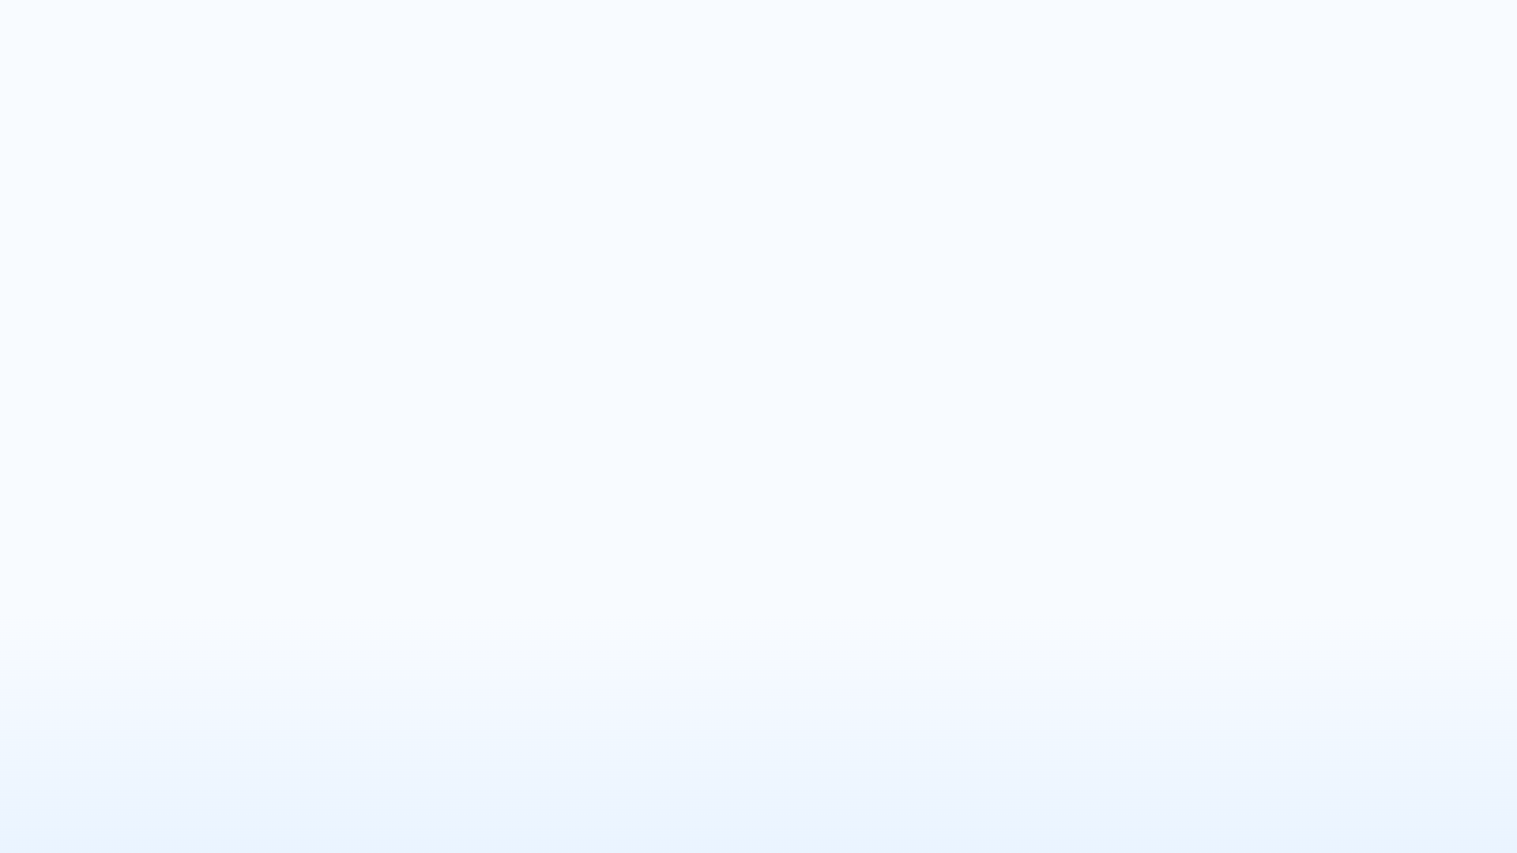




PRESENTATION OVERVIEW
From laptop pricing signals to a working prediction app
A guided path through the dataset, modeling choices, results, and the Streamlit experience.
01
02
Problem setup
Data foundation
Laptop pricing factors and the prediction goal.
Dataset, preprocessing, and feature engineering decisions.
03
04
Modeling results
Application and next steps
Model training, evaluation, and the best result.
Streamlit application, outcomes, and future scope.
Four steps, one story: from data to deployment.
ML project walkthrough

Slide 3



INTRODUCTION
AI pricing context
Laptop prices are shaped by specs, features, and trust signals
The model will learn how hardware and purchase factors combine to predict a fair price instantly.
What drives price
Laptop prices vary by brand and specifications
RAM, storage, CPU, and GPU are the core drivers
Display, OS, and warranty also shift the final price
Goal: predict prices instantly using AI

Slide 4

PROBLEM STATEMENT AND OBJECTIVES
Manual pricing is hard — the project turns complexity into a usable model
Compare the user problem on the left with the data and deployment approach on the right.
User problem
Project objective
1
Estimating fair laptop prices is difficult manually.
1
Collect, clean, and transform the dataset.
2
Many specifications make pricing decisions complex.
2
Train models and build a Streamlit app.
Why it matters
Outcome
Without structure, price comparison becomes slow and inconsistent.
A practical pipeline from raw specs to a usable price prediction tool.
Verdict
The project responds to pricing complexity by converting laptop data into a clean modeling workflow and a simple app interface.

Slide 5



DATASET OVERVIEW
Dataset Description
A compact laptop pricing dataset with record scale, feature breadth, and a single prediction target.
SCALE
FEATURES
TARGET
893
Price
Brand + Specs
Laptop records
Hardware signals
Prediction label
Enough rows to compare pricing patterns across brands and configurations.
Includes brand, RAM, storage, OS, CPU, GPU, and warranty.
The model learns to estimate laptop price from the feature set.

Slide 6



MACHINE LEARNING WORKFLOW
Data Preprocessing and Feature Engineering
Cleaning the dataset first, then converting raw phone attributes into model-ready signals.
Removed missing values and unwanted columns
WHY IT MATTERS
Kept only usable fields before modeling.
Raw columns become structured signals the model can actually compare.
Cleaned RAM and ROM values
Standardized storage fields for consistency.
This step reduces noise and turns descriptive phone specs into consistent inputs.
Converted text fields into numeric form
Prepared categorical inputs for learning.
FEATURE BLOCKS CREATED
Model-ready feature set
CPU · GPU · resolution · type
CPU and GPU descriptors
Cleaner inputs, stronger signal, simpler training.
Resolution and device type

Slide 7





MODEL TRAINING AND SELECTION
Random Forest led the comparison
Four regressors were compared on R², with a clear winner and a tight middle pack.
R² by model
Top model
Higher is better; Random Forest is the strongest fit.
Best performer
0.833
Random Forest Regressor
Close contenders
Extra Trees
0.799
Linear Regression
0.798
The middle two models are nearly tied, so the selection comes down to the best overall fit and stability.

Slide 8




MODEL EVALUATION
Deployment choice
Performance Evaluation
Random Forest selected
Measured with R² and MAE, then compared across candidates to select the most reliable deployment model.
Metrics
Ranking
Selection
We evaluated the models using R² score and MAE to capture fit quality and error size.
The comparison showed strong accuracy, with Random Forest performing best overall against the alternatives.
Random Forest was chosen for deployment because it combined the strongest overall performance with stable evaluation results.
Strong accuracy across the comparison set
R² score for explanatory power
Random Forest emerged as the top performer
Best overall fit for production use
MAE for average prediction error
Chosen model for deployment
Evaluation guided the final model choice from accuracy, error, and robustness.

Slide 9







WEB APP OVERVIEW
Streamlit Application
A clean interface for entering laptop specs and returning an estimated price with a category label.
Laptop Price Predictor
Fast estimate
WHAT THE APP DOES
Streamlit + Python model interface
Feature highlights
User inputs
Structured inputs
Estimated price
Brand, RAM, storage, and CPU anchor the prediction.
Brand
RAM
₹ —
Model output appears instantly after inputs are selected.
Expanded signals
Storage
CPU
GPU, warranty, and display size refine the estimate.
GPU
Warranty
Price category
Categorized result
Clear outputs
Shows an estimated price and a simple price category.
Display size
Supports quick comparison for budget, mid-range, and premium laptops.
13–17
Fast demo-ready workflow
ML web app
Built with
Model pack
Python
Streamlit + Joblib

Slide 10










RESULTS • ADVANTAGES • FUTURE SCOPE
Results, Advantages, and Future Scope
A balanced view of what the model already delivers and where it can grow next.
Current strengths
Future scope
Reliable output and a clean user experience
Expansion paths that increase utility
Accurate and fast laptop price prediction
Cloud deployment for wider access
User-friendly and AI-powered interface
Recommendations and smarter guidance
Strong foundation for decision support in laptop pricing.
Deep learning and live pricing can strengthen accuracy over time.
RECOMMENDATION
Use the current model as a dependable base, then add deep learning, live pricing, and cloud deployment.

Slide 11


CONCLUSION
Thank You
ML can estimate laptop prices effectively through thoughtful preprocessing and a strong Random Forest model.
Key takeaways
A complete workflow from preprocessing to deployment.
ML can estimate laptop prices effectively.
The project combines preprocessing and deployment.
Random Forest gave the strongest results.
Ready for questions and discussion
THANK YOU

